Slide 1

Psychometrics Lecture 3: Validity
Furr book chapters:
8: Conceptual basis
9: Estimating & evaluating validity evidence

Slide 2
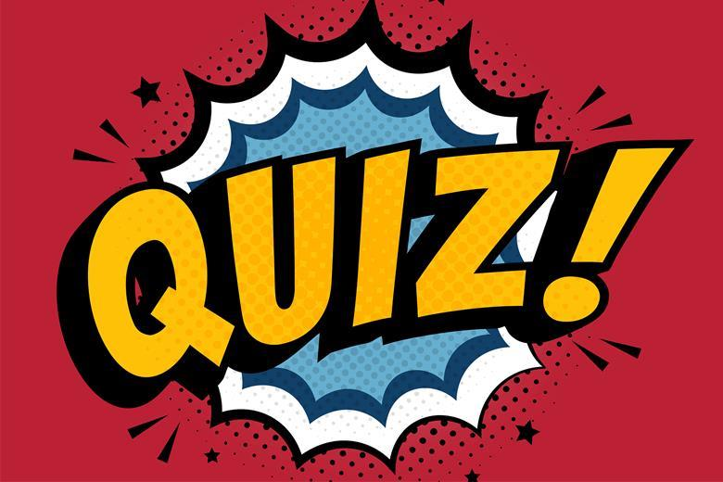
Validity
Reliability. To what extent:
Are the test scores a function of true scores?
Is the test free of random measurement errors?
Validity. To what extent:
Are the test scores what we intend to measure?
Is the test score free of systematic measurement errors?

Slide 3
Validity
Informally:
Does the test score measure what we want to measure?
Professionally:
“degree to which evidence and theory support
the interpretations of test scores for proposed uses”
(APA et al., 2014, Standards for Educational and Psychological Testing)

Slide 4
Evaluation of psychological tests in the Netherlands: COTAN
COTAN evaluates quality of psychological tests published in the Netherlands. Properties evaluated as N/A, insufficient, sufficient or good:
 | Sufficient or good (COTAN 2000) | Sufficient or good (assessments 1998 – 2018)
Theoretical basis | 88% | 90%
Quality of test materials | 91% | 94%
Quality of manual | 72% | 84%
Norms | 41% | 40%
Reliability | 67% | 76%
Construct validity | 65% | 67%
Criterion validity | 33% | 26%
Evers, Vliet-Mulder & Groot (2000). COTAN Documentatie van Tests en Testresearch in Nederland. Amsterdam: Boom Uitgevers.
Egberink, I.J.L., & Vermeulen, C.S.M. (2009-2018). COTAN Documentatie (www.cotandocumentatie.nl). Amsterdam: Boom Uitgevers.

Slide 5
Validity
Internal structure
Associations with other variables
Construct
Validity
Response Processes
Consequences of Use
Test Content

Slide 6
Validity
PCA
Regression analysis
Internal structure
Associations with other variables
Construct
Validity
Reliability
Sensitivity, specificity, positive and negative predictive value
IRT
CFA
Taylor-Russell table
Response Processes
Consequences of Use
Response bias
Method effects
Test Content
Facet method

Slide 7
1. Test content
Content validity:
If test is intended to measure a certain construct, items should correspond with sub-constructs (facets) of that construct.
Important in all phases of test development!
construct
sub-constructs
items

Slide 8
Addition
Example
• Construct
• Sub-constructs
• Items
Threats to content validity:
• Construct-irrelevant content. E.g., exponentation, items with (too) much verbal content.
• Construct-underrepresentation. E.g., only two items for division, no exponentiation.
These are choices of the test developer, but/thus have to be motivated and made explicit.
Subtraction
Maths ability
Multiplication
Division
maths questions

Slide 9
Addition
Example
• Construct
• Sub-constructs
• Items
Threats to content validity:
• Construct-irrelevant content. E.g., exponentation, items with (too) much verbal content.
• Construct-underrepresentation. E.g., only two items for division, no exponentiation.
These are choices of the test developer, but/thus have to be motivated and made explicit.
Subtraction
Maths ability
Multiplication
Division
maths questions

Slide 10
Addition
Example
• Construct
• Sub-constructs
• Items
These are choices of the test developer, have to be motivated and made explicit.
Threats to content validity:
• Construct-irrelevant content. E.g.: exponentiation, items with (too) much verbal content.
• Construct-underrepresentation. E.g.: only two items for division, no exponentiation.
Subtraction
Maths ability
Multiplication
Division
maths questions

Slide 11
ASO: Amsterdam Scale for Oppositionality (Hoffenaar & Hoeksma, 2003)
Situation: Response: | Teachers | Parents | Peers
Emotional | ? Items | ? Items | ? Items
Behavioral | ? items | ? Items | ? items
Facet method: Systematic method for ensuring content validity.
Define the relevant facets of the construct.
Define the relevant levels of the construct for each facet.
Create items to assess every possible combination of levels.

Slide 12
ASO: Amsterdam Scale for Oppositionality (Hoffenaar & Hoeksma, 2003)
Situation: Response: | Teachers | Parents | Peers
Emotional | 5 Items | 5 Items | 5 Items
Behavioral | 5 items | 5 Items | 5 items
Example items:
Not doing what the teacher demands …
□ I find it cool □ I find it stupid
When my mom or dad tells me to help …
□ I do it □ I pretend I did not hear it
Other children think that …
□ I sometimes argue □ I hardly ever argue

Slide 13
ASO: Amsterdam Scale for Oppositionality (Hoffenaar & Hoeksma, 2003)
Facet method: Systematic method for ensuring content validity
Content validity presented in one overview.
E.g., ask experts: Facets and levels complete? Weighting correct? Do items capture (all) relevant behavior?
Can use to assess if internal structure is as intended: Reliability (week 2), PCA (week 4) and CFA (week 5)
Situation: Response: | Teachers | Parents | Peers
Emotional | 5 Items | 5 Items | 5 Items
Behavioral | 5 items | 5 Items | 5 items

Slide 14
2. Internal structure of a test
Do indicators (items, subtests) for a construct form a coherent whole?
Yes: homogeneity → one underlying dimension
No: heterogeneity → multiple dimensions, possibly correlated
Assess using:
reliability analyses (week 2)
principal component analysis (PCA; week 4)
confirmatory factor analysis (CFA; week 5)
item response theory (IRT; week 6)

Slide 15
3. Response processes
To what extent is there consistency between the psychological processes:
that are assumed to be used by respondents, and
that are actually used by respondents
Inconsistencies occur, for example, in case of:
Social desirable responding
Cheating on an exam
Misunderstanding of an item
More about this in topic Bias (week 7)!

Slide 16
4. Associations with other variables
Convergent vs. discriminant validity evidence.
Concurrent vs. predictive validity evidence.

Slide 17
Nomological Net
A network of constructs of interest, their observable manifestations, and the interrelationships between them.
The term "nomological" derives from the Greek, means "law-like".
In test development, used to test whether associations with other variables support validity.
First, make explicit what associations are expected.
Next, compare these with observed associations (i.e., correlations obtained from a sample of respondents)
Sidenote: The network never contains all variables of relevance, because behaviour is affected by an endless number of influences.

Slide 18
Geneve Emotion Recognition Test (GERT)
Construct of interest: Ability to recognize people’s emotions from their face, voice and body.
83 short video clips in which actors express different emotions, respondent is asked which emotion was expressed
Test score: Number of video’s where emotion is correctly recognized.
Try it out at: https://www.unige.ch/cisa/emotional-competence/home/exploring-your-ec/
Schlegel et al. (2017) constructed the following nomological net in one of their studies:
Some abbreviations used: TEIQue (Trait Emotional Intelligence Test), RSES (Rosenberg Self-Esteem Scale), ASR (Adult Self-Report)

Slide 19
GERT

Slide 20
(-) 0.10 to 0.30: low to moderate (thinner lines)
(-)0.30 to 0.50: moderate to strong (thicker lines)
Authors expected:
Small positive correlation with gender.
Substantial negative correlation with age.
No correlation with self-esteem.
GERT
Self-esteem
RSES
Age
Gender (1=female)

Slide 21
Authors expected:
Small positive correlation with gender.
Substantial negative correlation with age.
No correlation with self-esteem.
Strong positive correlations with emotional intelligence.
GERT
Self-esteem
RSES
Situational emotional understanding
STEU
Situational emotional management
STEM
Age
Gender (1=female)

Slide 22
Wellbeing
TEIQue
Social Adjustment
ASR
Personal Strength
ASR
Self-control
TEIQue
Authors expected:
Small positive correlation with gender.
Substantial negative correlation with age.
No correlation with self-esteem.
Strong positive correlations with emotional intelligence.
Low to moderate positive correlations with adaptive personality traits.
Emotionality
TEIQue
Sociability
TEIQue
GERT
Self-esteem
RSES
Situational emotional understanding
STEU
Situational emotional management
STEM
Age
Gender (1=female)

Slide 23
Wellbeing
TEIQue
Social Adjustment
ASR
Personal Strength
ASR
Self-control
TEIQue
Authors expected:
Small positive correlation with gender.
Substantial negative correlation with age.
No correlation with self-esteem.
Strong positive correlations with emotional intelligence.
Low to moderate positive correlations with adaptive personality traits.
Low to moderate negative correlations with maladaptive traits.
Emotionality
TEIQue
Sociability
TEIQue
GERT
Self-esteem
RSES
Situational emotional understanding
STEU
Situational emotional management
STEM
Age
Gender (1=female)

Slide 24
Wellbeing
TEIQue
Social Adjustment
ASR
Personal Strength
ASR
Anxiety
ASR
Self-control
TEIQue
Withdrawal
ASR
Emotionality
TEIQue
Somatic problems
ASR
Thought problems
ASR
Sociability
TEIQue
GERT
Rule-breaking
ASR
Self-esteem
RSES
Attention problems
ASR
Situational emotional understanding
STEU
Aggression
ASR
Situational emotional management
STEM
Depression
ASR
Age
Gender (1=female)

Slide 25
Wellbeing
TEIQue
Social Adjustment
ASR
Personal Strength
ASR
Anxiety
ASR
Self-control
TEIQue
Withdrawal
ASR
Emotionality
TEIQue
Somatic problems
ASR
Thought problems
ASR
Sociability
TEIQue
GERT
Rule-breaking
ASR
Self-esteem
RSES
Note: All are concurrent, not predictive validity coefficients. Only 1 coefficient is discriminant validity.
Attention problems
ASR
Situational emotional understanding
STEU
Aggression
ASR
Situational emotional management
STEM
Depression
ASR
Age
Gender (1=female)

Slide 26
Wellbeing
TEIQue
Social Adjustment
ASR
Personal Strength
ASR
Anxiety
ASR
0.07
0.05
0.18
0.10
Self-control
TEIQue
Withdrawal
ASR
0.04
0.04
Emotionality
TEIQue
Somatic problems
ASR
0.07
0.19
Thought problems
ASR
Sociability
TEIQue
0.06
0.11
GERT
Rule-breaking
ASR
Self-esteem
RSES
0.07
-0.04
Attention problems
ASR
0.18
Situational emotional understanding
STEU
Aggression
ASR
0.46
0.11
Situational emotional management
STEM
Depression
ASR
Gender (1=female)
0.09
Age
0.36
-0.35
0.19

Slide 27
Wellbeing
TEIQue
Social Adjustment
ASR
Personal Strength
ASR
Anxiety
ASR
0.07
0.05
0.18
0.10
Self-control
TEIQue
Withdrawal
ASR
0.04
0.04
Emotionality
TEIQue
Somatic problems
ASR
0.07
0.19
Thought problems
ASR
Sociability
TEIQue
0.06
0.11
GERT
Rule-breaking
ASR
Self-esteem
RSES
0.07
-0.04
Attention problems
ASR
0.18
Situational emotional understanding
STEU
Aggression
ASR
0.46
0.11
Situational emotional management
STEM
Depression
ASR
Gender (1=female)
0.09
Age
0.36
-0.35
0.19

Slide 28
4. Associations with other variables / 5. Consequences of testing: Decision making
Decisions based on tests are often dichotomous:
accept / reject
treatment / no treatment
has disorder / does not have disorder
Want to maximize correct decisions, minimize wrong decisions
But two different types of correct and wrong decisions, with different gains and costs dependent of the testing context (and viewpoint).
Real status Decision | Does not have disorder / not suitable | Has disorder / suitable
No | Correct decision | Wrong decision
Yes | Wrong decision | Correct decision

Slide 29
4. Associations with other variables / 5. Consequences of testing: Decision making
Decisions based on tests are often dichotomous:
accept / reject
treatment / no treatment
has disorder / does not have disorder
Want to maximize correct decisions, minimize wrong decisions
But two different types of correct and wrong decisions, with different gains and costs dependent of the testing context (and viewpoint).
Real status Decision | Does not have disorder / not suitable | Has disorder / suitable
No | Correct decision | Wrong decision
Yes | Wrong decision | Correct decision

Slide 30
Decision making
Real status Decision | Does not have disorder / not suitable | Has disorder / suitable
No | 3168 | 3308 | 6476
Yes | 432 | 3092 | 3524
 | 3600 | 6400 | 10000
sensitivity | 0,48
specificity | 0,88
positive predictive value | 0,88
negative predictive value | 0,49
Acceptable for screening for depression?
Acceptable for diagnosing a severe disorder?
Acceptable for deciding to apply heavy, costly treatment?

Slide 33
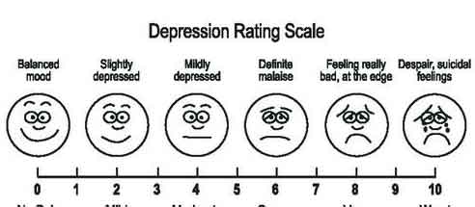
Predictive validity: Taylor-Russell procedure
Problem: Test score on ordinal or interval scale, but have to make dichotomous decision (e.g., reject or admit).
Effect of policy: Different cut-off points yield different selection ratios and percentages of “successes” → Taylor-Russell table

Slide 34
Predictive validity: Taylor-Russell procedure
Problem: Test score on ordinal or interval scale, but have to make dichotomous decision (e.g., reject or admit).
Effect of policy: Different cut-off point yields different selection ratio and percentage of “successes” → Taylor-Russell table
Reject
(correct and incorrect decisions)
Admit
(correct and incorrect decisions)
Success!

Slide 35
Example: Medical school admissions
Background information
6500 applications, 2850 places
selection ratio is given: 2,850/6,500 = .44
Current probability of success (base rate): .50
Current policy: weighted lottery according to average grade on final exams
Selection question
• Given this selection ratio and base rate of current procedure, can we improve success rate by adding a selection test, which correlates .20 with success in medical school?

Slide 36
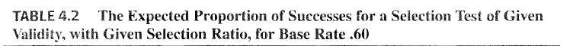
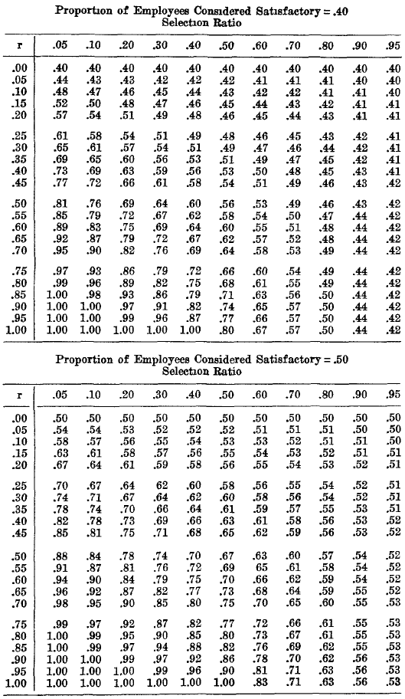
Taylor-Russell table
• Given the base rate (current prop. of successes among selected individuals; .50),
Given the selection ratio (prop. of individuals that can be selected; .44),
Given the predictive validity of extra test (correlation between test and criterion; .20).
What will the proportion of successes be if 44% highest scorers on the extra test are admitted?
• New proportion of successes ≈ .57 → “gain” ≈ 7 percentage points or ≈ 14%.

Slide 37
Remarks Taylor-Russell table
With less than perfect predictive validity, can still increase probability of success!
Decision whether new test procedure will be used will also be based on
Costs of additional testing procedure
Cost/benefits of (un)successful admissions
Have to make sure validity coefficient is representative for current situation

Slide 38
5. Consequences of testing
Psychological testing may have adverse or unfair consequences:
Groups: E.g., women score systematically higher than men on a test for conscientiousness. Fair to use for selecting job applicants?
Individuals: E.g., can we use a test that has low reliability and/or predictive validity to make high-stakes decisions about an individual?

Slide 39
Factors affecting validity coefficients
True association between constructs
Measurement error and reliability
Restricted range
Skew and relative proportions
Method variance
Time
Single versus multiple events
Good!
Problems we have to take into account

Slide 40
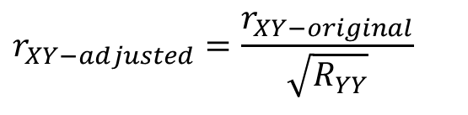
2. Measurement error and reliability
According to Eq. 9.1 (same as Eq. 7.3):
Therefore, the maximum value of the correlation between two test scores is (cf. WG 2):
WG: We can correct observed correlation for unreliability of the criterion (Y), using Equation 9.2:
Note difference with Equation 7.7, correction for attenuation, which corrects for unreliability of both X and Y)
$$r_{XY−adjusted}=\frac{r_{XY−original}}{\sqrt{R_{YY}}}$$

Slide 41
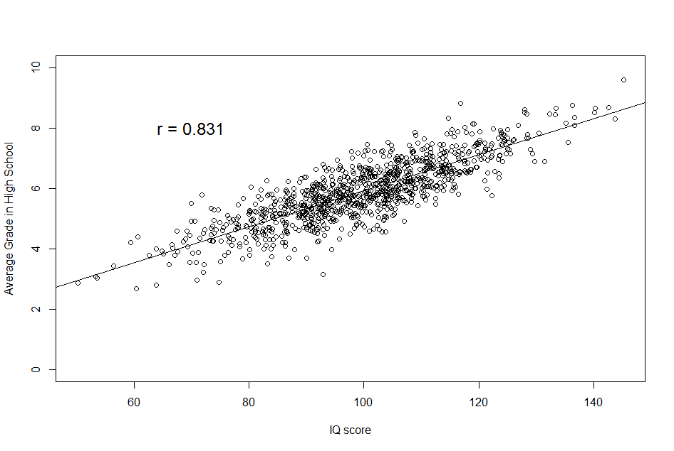
3. Restricted range
If range of the test score and/or criterion variable is restricted, then the observed correlation will underestimate the true correlation:

Slide 42
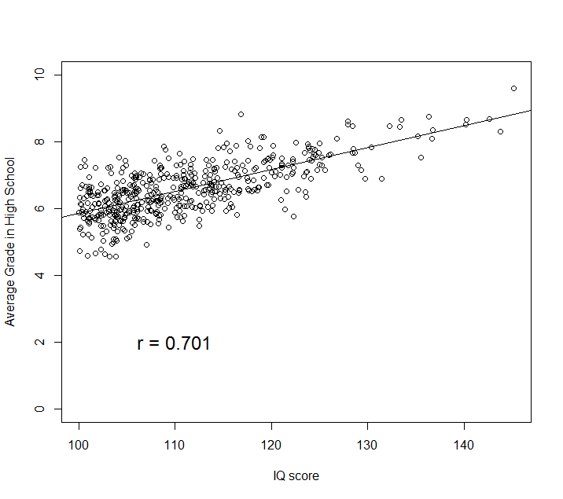
3. Restricted range

Slide 43
4. Skew and Relative Proportions
If distributions are skewed, the observed correlation will be smaller (closer to zero):
Grade ≥ 5.8 is “adequate”
Grade < 5.8 is “inadequate”

Slide 44
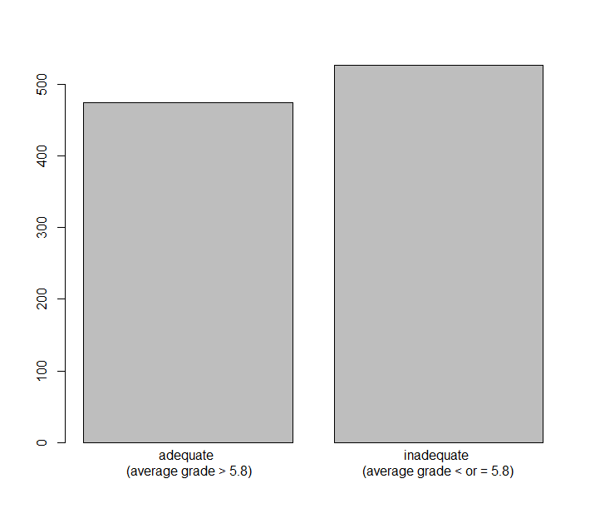
4. Skew and Relative Proportions
If distribution of test or criterion is skewed, the observed correlation will be closer to zero:
Correlation with IQ: .65

Slide 45
4. Skew and Relative Proportions
If distribution of test or criterion is skewed, the observed correlation will be closer to zero:
Grade ≥ 7.5 is “adequate”
Grade < 7.5 is “inadequate”

Slide 46
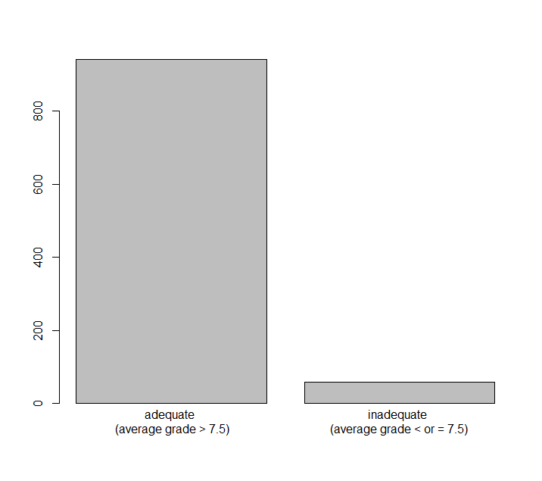
4. Skew and Relative Proportions
If distribution of test or criterion is skewed, the observed correlation will be closer to zero:
Correlation with IQ: .65
Correlation with IQ: .44

Slide 47

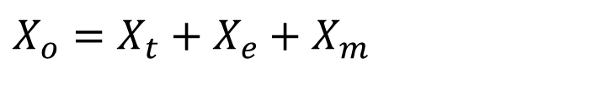
5. Method variance
Correlations between measurement with:
same method tend to be higher
different methods tend to be lower
This is known as a ‘method effect’
Method effect rarely can be eliminated completely.
Hopefully, the effect of the true score (the underlying trait) is much stronger than the effect of the method.
$$X_{o}=X_{t}+X_{e}+X_{m}$$

Slide 48
Wellbeing
TEIQue
Social Adjustment
ASR
Personal Strength
ASR
0.05
0.18
0.10
Self-control
TEIQue
0.04
Emotionality
TEIQue
0.19
Sociability
TEIQue
0.11
GERT
Performance tests
Situational emotional understanding
STEU
0.46
Self-report questionnaires
Situational emotional management
STEM
0.36

Slide 49
6. Time
More time between measurement occasions -> lower correlations
Thus: predictive validity coefficients are generally lower than concurrent validity coefficients
E.g., correlation of .25 between current test score and a criterion measured 5 years later is quite impressive!

Slide 50
7. Single vs. multiple events
Specific events are inherently difficult to measure and predict -> lower validity coefficients
Summing or averaging over items/situations/ timepoints often provides better estimate of targeted construct -> larger validity coefficients
Construct | Single specific situation | Sum / average
Depression | What is you current mood (1-10)? | Average over multiple timepoints and/or days
Math ability | Single math question response | Number correct on 30-item math test

